Slide 1
The Parallax of ICD Therapy
2012
John Mandrola

Slide 2
Parallax…
…the effect whereby the position or direction of an object appears to differ when viewed from different positions, e.g., through the viewfinder and the lens of a camera.

Slide 3
Annual Deaths From SCD in US
SCD¹
CVA²
Lung³ Cancer
Auto⁴ Accidents
Breast³ Cancer
AIDS⁵
Fires⁶
¹ NASPE, May 2000, ² American Heart Association 2000, ³ National Cancer Institute 2001, ⁴ National Transportation Safety Board, 2000,
⁵ Center for Disease Control 2001, ⁶ NFPA, US Facts & Figures, 2000
Notes:
Sudden cardiac death is the most common cause of death. SCD is often predictable and preventable with ICD therapy. The total deaths from SCD are greater than the total deaths from breast cancer, lung cancer and AIDS combined.

Slide 4
Sudden Cardiac Death
Another view

Slide 5
Brief
Painless
Peaceful
Merciful

Slide 6
A Quandary
SCD
ICDs

Slide 7
Internal Cardiac Defibrillator (ICD)

Slide 8
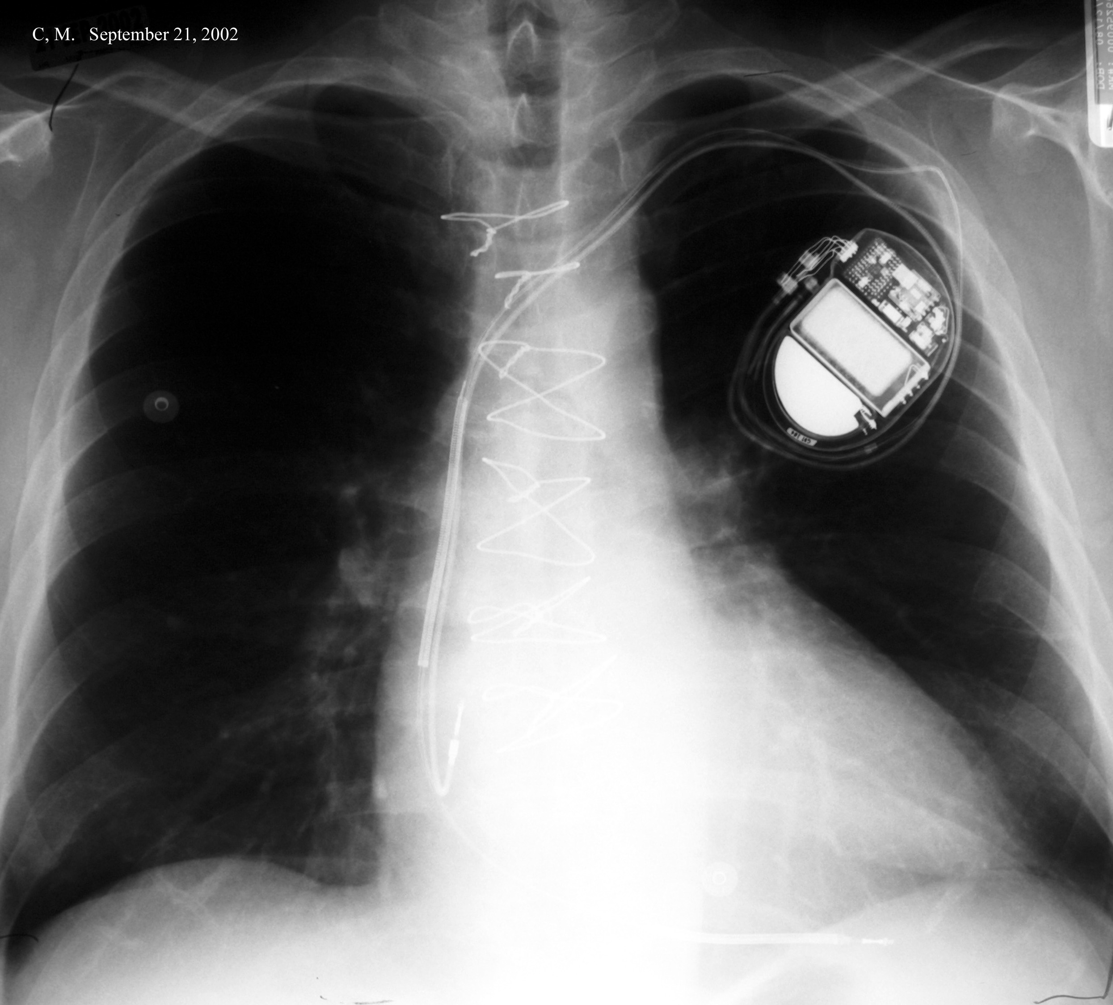
“Hot” Can
Proximal Coil
Atrial lead
Distal Coil

Slide 9
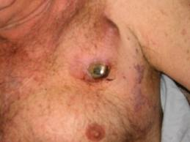
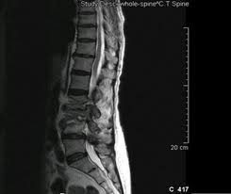
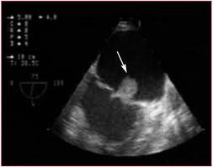
Another view…

Slide 10
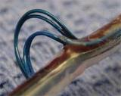
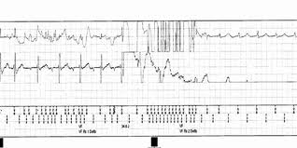
And yet another view seen lately
Intra-cardiac Device Failures
St Jude Riata
Medtronic Sprint Fidelis

Slide 11
Real ICD Stories

Slide 12
Patrick
17 years old when he had SCD at home
  w/u negative
  ICD placed for idiopathic VF
22 years old
  ICD shock while at college
  Evaluation from device showed VF
Now… Patrick is 31; takes 25mg of metoprolol daily; coaches and teaches High School and is engaged to be married.
  No more shocks

Slide 13
Liz
24 years old
  Syncope and seizures
  ICD placed for newly-diagnosed Long QT syndrome
At 26 she had her first and only shock during sleep for VF
  Takes 12.5 mg of metoprolol daily
At 32, she is doing well; Liz is…
  a mom
  a wife
  She is alive!

Slide 14
Dorothy
Age 74—Prior IMI, EF-35%
Original ICD placed after she presented with sustained VT and syncope
  Months later, more VT/Shocks necessitate Amiodarone
Years go by and VT returns
  2 VT ablations done—Amio stopped
Heart block occurs and an atrial lead is added.
More years go by…
Then CHF from chronic RV pacing
  LV lead placed
  CRT-D gives her new life!
17 years later she strolls into my office with 2 great-grandchildren in tow
  No shocks or recent CHF
  “I want to make it to 100”!

Slide 15
And here’s another ICD patient…

Slide 16
Intro to HRS Consensus Statement on ICDs as patients reach end of life
“His defibrillator kept going off . . . It went off 12 times in one night...He went in and they looked at it...they said they adjusted it and they sent him back home. The next day we had to take him back because it was happening again. It kept going off and going off and it wouldn’t stop going off.”

Slide 17
Parallax

Slide 18
Secondary Prevention
Was the only indication for ICDs before 2001

Slide 19
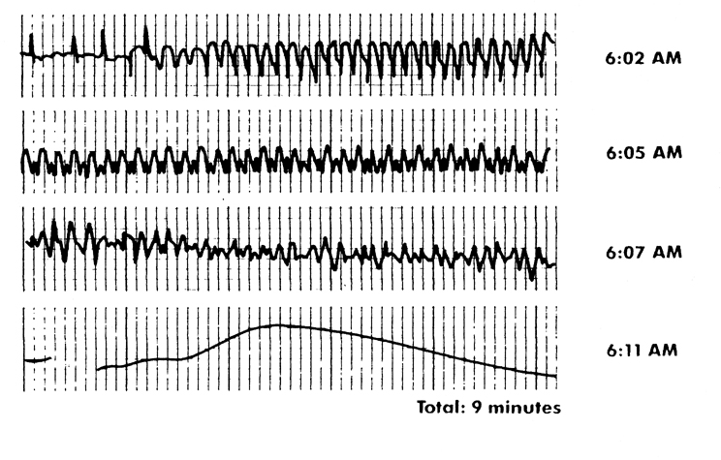
Holter monitor reading from a patient who did not have a defibrillator. He died at 6:11 am on the golf course.

Slide 20
Primary Prevention with ICDs
Sudden Cardiac death is often the first manifestation of heart disease
  Approximately 20% of the time
  Scary
Out of hospital Cardiac Arrest has a dismal prognosis

Slide 21
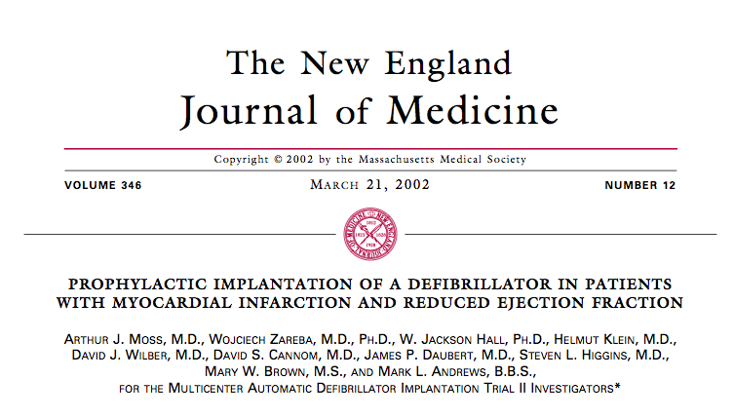

Slide 22
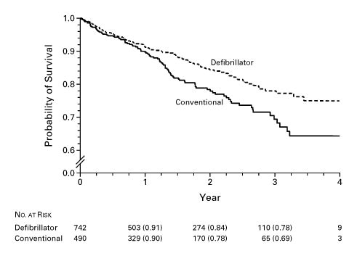

Kaplan–Meier Estimates of the Probability of Survival in the Group Assigned to Receive an Implantable Defibrillator and the Group Assigned to Receive Conventional Medical Therapy.
MADIT II Trial--Ischemic
Moss AJ et al. N Engl J Med 2002;346:877-883.
Notes:
Figure 2. Kaplan–Meier Estimates of the Probability of Survival in the Group Assigned to Receive an Implantable Defibrillator and the Group Assigned to Receive Conventional Medical Therapy. The difference in survival between the two groups was significant (nominal P=0.007, by the log-rank test). Figure 3. Hazard Ratios and 95 Percent Confidence Intervals for Death from Any Cause in the Defibrillator Group as Compared with the Group Assigned to Receive Conventional Medical Therapy, According to Selected Clinical Characteristics. The hazard ratios in the various subgroups were similar, with no statistically significant interactions. The dotted vertical line represents the results for the entire study (nominal hazard ratio, 0.66, without adjustment for the stopping rule). The horizontal lines indicate nominal 95 percent confidence intervals. LVEF denotes left ventricular ejection fraction, and NYHA New York Heart Association.

Slide 23
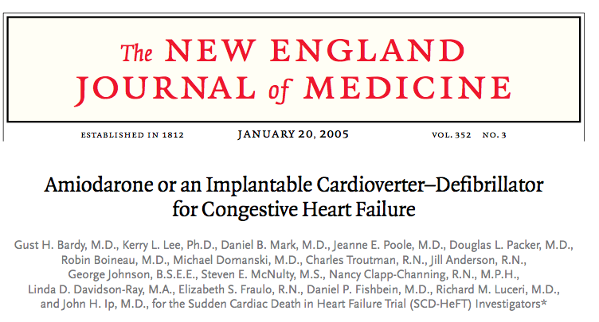

Slide 24
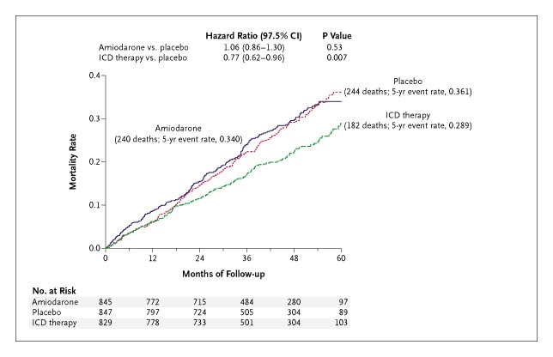
SCD-HeFT Results
Ischemic + Dilated CM
Bardy GH et al. N Engl J Med 2005;352:225-237.
Notes:
Figure 1. Kaplan–Meier Estimates of Death from Any Cause. CI denotes confidence interval.

Slide 25
“Experts,” guideline writers and the general consensus in Cardiology interpreted these trials one way…

Slide 26
Patients with EF <35% should have an ICD
Or else…
  They might die
  You will be liable

Slide 27

Others saw something like this…

Slide 28
Others thought more…

Slide 29
Who were these patients in MADIT II and SCD-HeFT?
Young (Mean age 64; 60) w/prior MI or LVD
In MADIT II – 35% had NYHA Class 1 symptoms
One-third or less were females
One-quarter or less were non-white
Two-thirds were without diabetes
No CKD
Sick enough to be at risk for VF,
but not so sick to be dying of competing causes

Slide 30
And the thinkers kept on…

Slide 31
No prospective randomized controlled clinical trial of ICDs used solely in patients
with non-ischemic dilated cardiomyopathy has ever shown better outcomes

Slide 32
No one listened to this voice…

Slide 33
ICDs in CHF
“Another problem with the ICDs is that heart failure remains a progressive disease. So if a patient has an ICD implanted, essentially that patient has lost the chance to go peacefully (and quickly) before becoming miserable”
(Lynne Warner-Stevenson 2002)

Slide 34
Then comes this trial…
Three years after SCD-HeFT

Slide 35
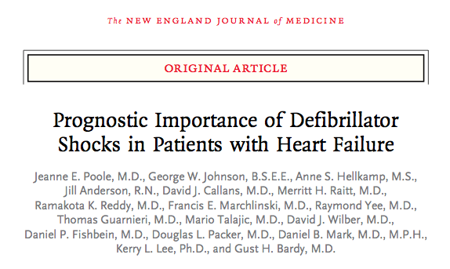
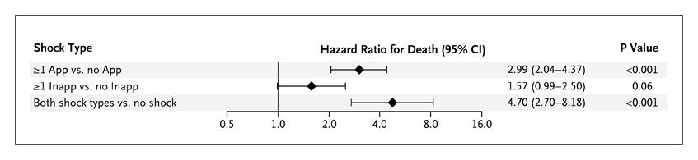
Median Survival after appropriate shock
168 days
Poole JE et al. N Engl J Med 2008;359:1009-1017.
Notes:
Figure 2. Hazard Ratios for the Risk of Death among Patients Who Survived at Least 24 Hours after a First ICD Shock. The association of shock types with the risk of death among patients who survived at least 24 hours after a first ICD shock of either type is shown, adjusted for baseline prognostic factors identified in the trial (age, sex, cause of heart failure, New York Heart Association class, time since the diagnosis of heart failure, left ventricular ejection fraction, distance covered on a 6-minute walk, systolic blood pressure, presence or absence of diabetes, use or nonuse of angiotensin-converting–enzyme inhibitors, use or nonuse of digoxin, presence or absence of mitral regurgitation, renal sufficiency or insufficiency, presence or absence of a history of substance abuse, baseline electrocardiographic intervals, and score on the Duke Activity Status Index7). App denotes appropriate defibrillator shock, CI confidence interval, and Inapp inappropriate defibrillator shock.

Slide 36
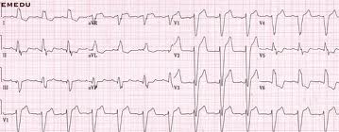
An exception to the rule that ICDs only increase quantity of life

Slide 37
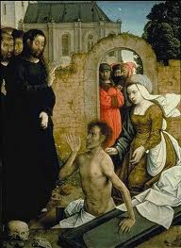
Cardiac Resynchronization Therapy --CRT

Slide 38
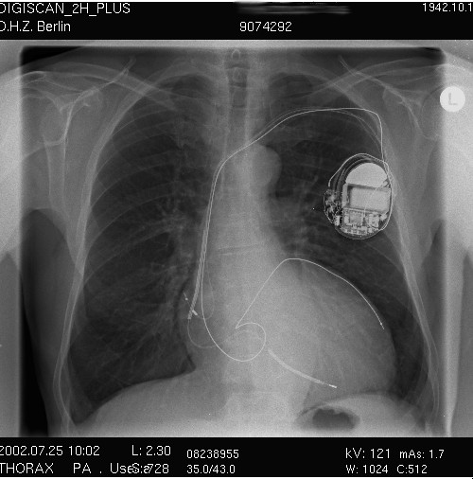

Slide 39
Phrenic Nerve
RV
LV
.
Notes:
Note the distance between the LV and the RV lead, which is located in the RV apex. The RA lead was placed anteriorly.

Slide 40
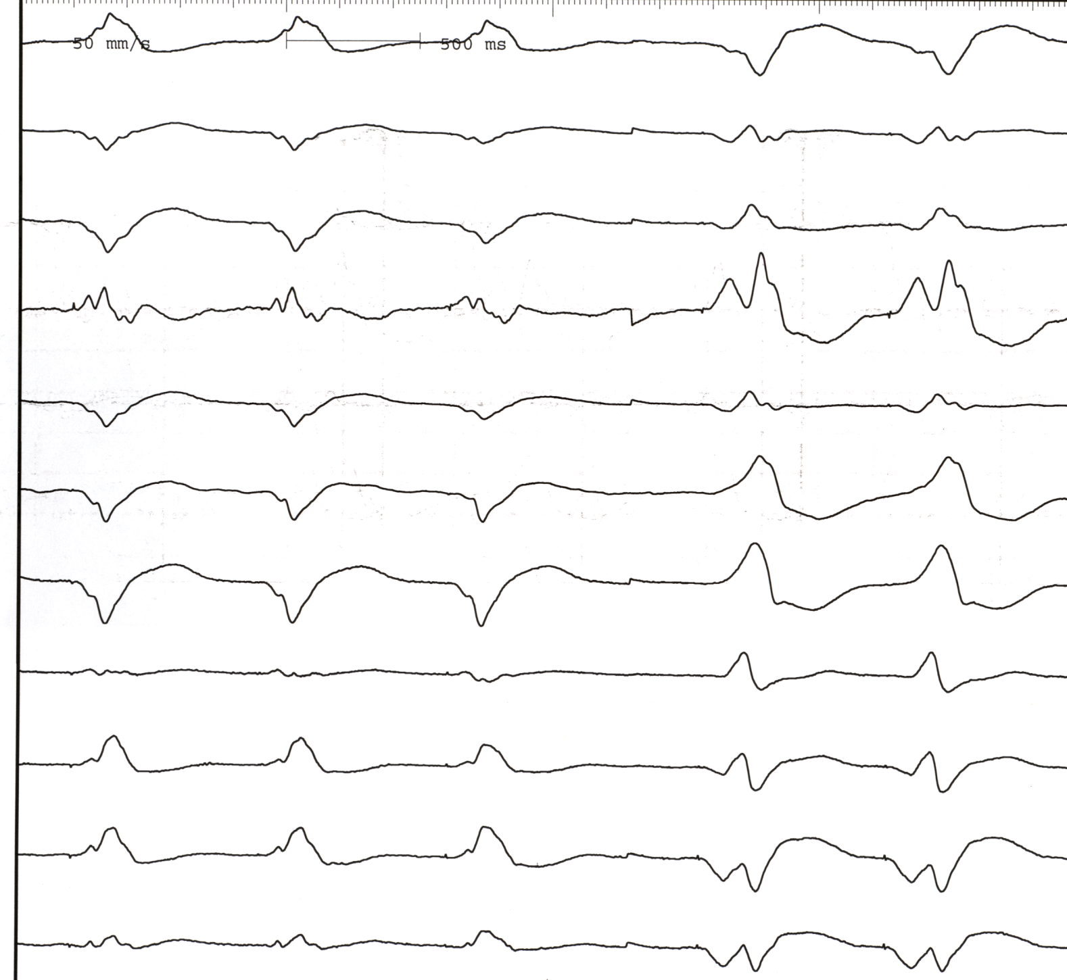
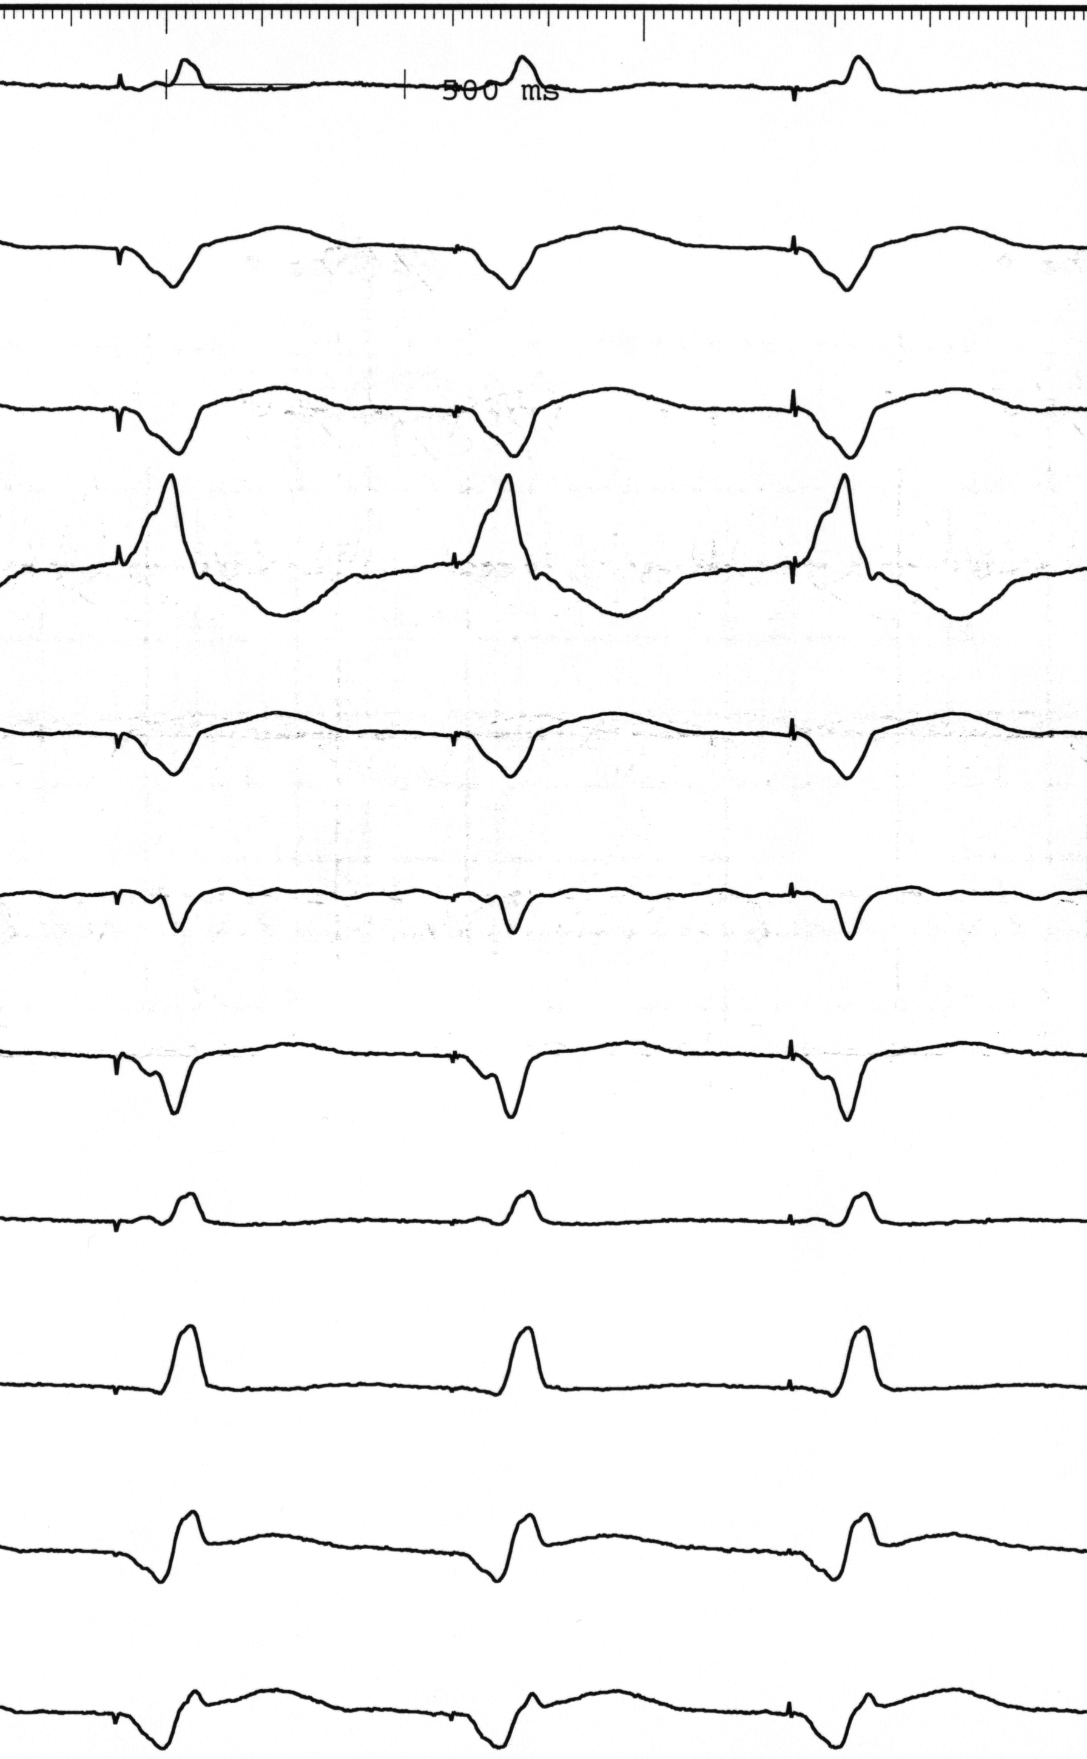
Comparison of single ventricle and biventricular pacing
I
II
RV Pacing
LV Pacing
BiV Pacing
III
290 msec
320 msec
190 msec
AVR
AVF
V1
V2
V3
V4
V5
V6

Slide 41
CRT-Cardiac Resynchronization Therapy
Indicated in patients with:
  Class 2-3 NYHA Failure
  LV systolic dysfunction w/ septal dyskinesis
  LBBB (QRS at least greater than 130 msec)
  Both ischemic and non-ischemic patients can benefit
Selected patients respond 80% of the time
  Often improve a full functional class
  Emerging data suggest that CRT may induce favorable structural remodeling
Scar burden, narrowness of QRS and advanced LV dysfunction predict non-response
Women with dilated CM benefit the most.

Slide 42
CRT (with or without “D”)
Consensus
  CRT lowers all cause mortality
  CRT-D may lower all cause mortality incrementally
    Only one trial
Patients should be given a choice
  Most heart docs defer to ‘Cadillac’ thinking—ICD is better
Another take:
  CRT offers the “advantage” CHF therapy with out eliminating painless SCD

Slide 43
Cardiac Device Deactivation

Slide 44
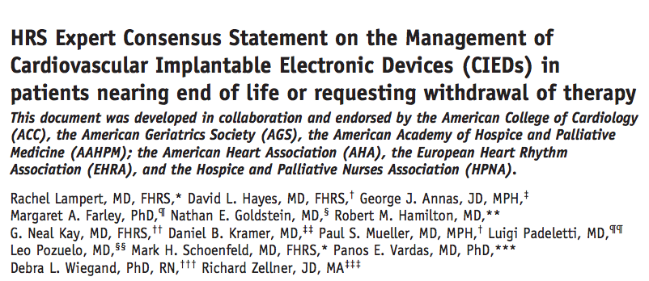
Heart Rhythm, Vol 7, No 7, July 2010

Slide 45
Take home messages from the 2010 HRS document
Patients have the right to refuse or withdraw any medical therapy, regardless of their health and even if withdrawal may result in death
  The right to refuse or withdraw RX is a personal right of the patient and does not depend on the details of the treatment involved
  This includes pacemakers in dependent patients

Slide 46
HRS Document (2)
Legally or ethically, carrying out a request to withdraw life-sustaining treatment is neither physician-assisted suicide or euthanasia

Slide 47
HRS Document (3)
Communication about cardiac devices should be part of the larger conversation concerning goals of care
  This dialogue is an ongoing process that starts before implant and should continue over time.

Slide 48
HRS Document (4)
A clinician cannot be compelled to carry out deactivation if he/she objects on a personal level to the procedure
  But…the clinician cannot abandon the patient and is compelled to involve a colleague.

Slide 49
HRS document (5)
The deactivation process should include anticipation of symptoms and appropriate palliative care planning for both the patient and family

Slide 50

My (Optimistic) Conclusion:
In delivering both high-tech and enlightened cardiac care, in a shared decision-making model, I see light off in the distance

