Slide 1
Gender-specific Results of Atrial Fibrillation Ablation in a Private Practice Setting
John M Mandrola, MD, Vicky A Swift, APRN, Kathryn Grace Thorne, MS, Sean Kettring, David E Mann, MD. Baptist Hospital East, Louisville, KY.
No Author has any disclosures

Slide 2
Abstract
Introduction: Most of the data supporting catheter ablation of atrial fibrillation (AF) come from trials performed at academic centers that enrolled mostly men. A few centers have reported that females may fare less well with AF ablation, but no gender-specific data exist from a private practice setting. We report a series of patients who either underwent AF ablation or palliative AV node ablation. Hypothesis: We assessed the hypotheses that females are under-represented in AF ablation but overrepresented in AV node ablation, and females with AF may be more difficult to ablate. Methods: We reviewed hospital records of patients that had AF ablation in our 500-bed community hospital from 1/2007 to 5/2011. AF was ablated with wide area pulmonary vein isolation (PVI) guided by 3D-imaging, and a lasso-catheter confirmed PVI. Non-PV triggers, complex-fractionated electrograms and organized atrial flutters were ablated at the discretion of the operators (PVI+). For comparison, we included patients referred for AV-node ablation over the same time frame. Results: PVI was achieved in 233 of 234 patients (mean age 60±9 years). Acute complications occurred in 4 of 234: tamponade (2), stroke (1), and phrenic nerve injury (1). Palliative AV node ablation was done in 115 patients. Females accounted for 33% (79/234) of AF ablations (p< 0.001), but 60% (69/115) of AV node ablations (p=0.03). In the AF ablation group, the mean age of females (62; range 21-80) did not differ from males (60; 34-76), however, in the AV node ablation group, the mean age of females (79; 55-92) was greater than males (74; 51-91) (p=0.003). Ablation beyond standard PVI (PVI+) was performed in 38% (30/79) of females and 31% (48/155) of males (p=0.04). Repeat AF ablations were performed in 29% (23/79) of females versus 25% (39/155) of males (p=0.04). Conclusions: (1) Females with AF were significantly under-represented in the AF ablation group, but over-represented in an older cohort that had AV node ablation. (2) Females were more likely to require repeat AF ablations. (3) Additional ablation, beyond PVI, was more often performed in females. Further studies are needed to determine if these findings are due to gender bias in the management of females or actual differences in the AF substrate between sexes.

Slide 3
Introduction/Background

Slide 4
There are two general strategies used to treat AF:
Rate-control or Rhythm-control
AF ablation is now an accepted rhythm-control strategy
In 2011, AF ablation is commonly done outside of academic medical centers
The evidence base supporting AF ablation comes from trials conducted at academic medical centers
These trials enrolled mostly men
Though scant data exist on gender-related results of AF ablation, a few centers have reported that females fare less well with AF ablation

Slide 5
Hypothesis

Slide 6
We asked two questions:
In a real-world, private practice setting of two electrophysiologists practicing at a community hospital…
Are females under-represented in AF ablation but over-represented in palliative AV node ablation?
Is AF in females more difficult to ablate?

Slide 7
Methods

Slide 8
We reviewed hospital records of consecutive patients that had AF ablation or AV node ablation in our 500-bed community hospital from 1/2007 to 8/2011.
All procedures were done by two electrophysiologists (JM or DM)
Patients considered for AF ablation had either paroxysmal or persistent AF
Permanent AF was not ablated.
AF was ablated with wide area pulmonary vein isolation (PVI), guided by 3D non-fluoroscopic imaging (Biosense) and a lasso-catheter confirmed PV isolation

Slide 9
Non-PV triggers, complex-fractionated electrograms and organized atrial flutters were ablated at the discretion of the operators (PVI+)
Left atrial ablation beyond standard PVI was done either when felt necessary to eliminate persistent AF or when non-AF arrhythmias (left atrial flutter/tachycardia) persisted after PV isolation
AF ablation success was determined by clinical follow-up:
Assessment of symptoms, ECG and ambulatory-ECG monitoring (when indicated)
Long-term success rates included repeat procedures
Statistical analysis was performed with chi-square and two-tailed t-tests

Slide 10
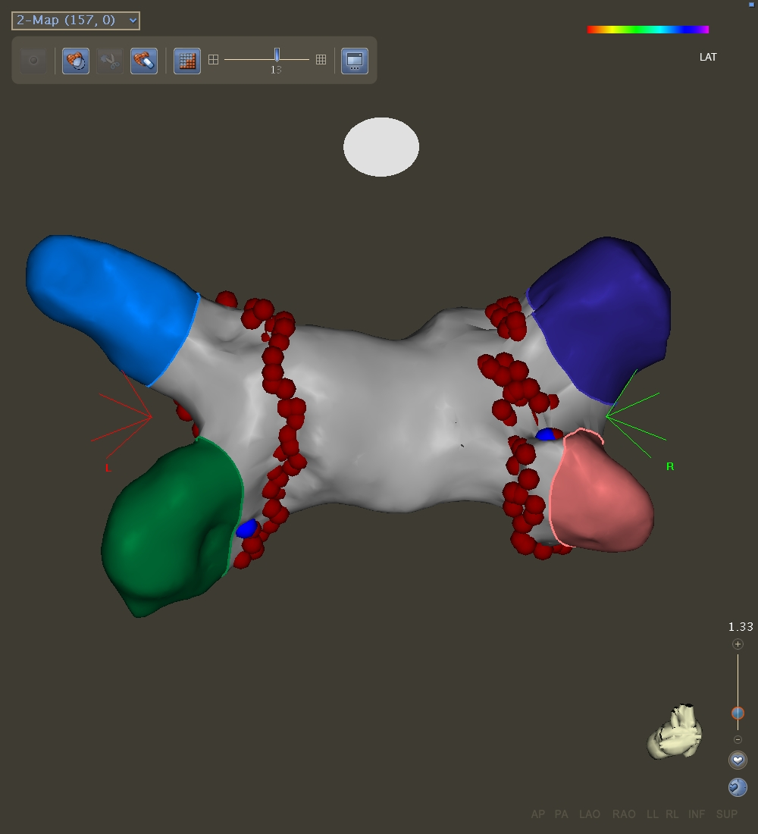
AF ablation--PVI Procedure
Point by point RF lesions were made with a saline-irrigated tip catheter
Maximum RF energy used on the posterior wall was 20-25 watts and 40 watts anteriorly
All patients after June 2009 had general anesthesia
Nearly all patients underwent AF-ablation with therapeutic INRs (≥2), or were bridged with low-molecular weight heparin

Slide 11
Results

Slide 12
 | Patients | AF Procedures | AV-Node Ablation procedures | Mean Age (AF Ablation) | Mean Age (AV node ablation)
Males | 148 | 190 | 46 | 59 ± 9 | 74 ± 8
Females | 65 | 92 | 69 | 61 ± 10 | 79 ± 7
Total | 213 | 282 | 115 | P = ns | P = 0.03
PVI was acutely successful in 212 of 213 patients
Four patients had severe complications:
1 Right Phrenic Nerve paralysis (resolved at one year)
1 Stroke (non-lethal)
2 Acute tamponade requiring chest tube drainage
No patient died as a result of the procedure
No patient had symptoms or findings of PV Stenosis

Slide 13
Males versus Females in AF ablation and AV node ablation
Patients
*p < 0.001
*p = 0.03
69%
31%
60%
40%

Slide 14
Repeat AF ablations by gender
Percent of
patients w/ re-do
ablation
*p= 0.02
35%
44%
Patients 53/148 29/65
[9 patients (5 Females) had two repeat procedures]

Slide 15
AF ablation with left atrial ablation beyond standard PVI
Percent of procedures with additional LA ablation
17%
P = 0.08
26%
Total Procedures | 190 | 92
PVI (+) Left atrium | 33 | 24

Slide 16
Long-term success by gender
Follow-up duration:
Males: 16.4 months ± 15.5
Females: 16.1 months ± 15.8
p=ns
*P = 0.04
*P = 0.05
success
91%
81%
71%
58%
Patients 135 53 106 38

Slide 17
Conclusions

Slide 18
Females with AF were significantly under-represented in the AF-ablation group, but over-represented in an older cohort that had AV node ablation.
Females were more likely to require repeat AF ablations.
Females had lower long term success with AF ablation, either on or off rhythm-control drugs.
There was a trend for females to have additional ablation in the left atrium beyond standard PVI.

Slide 19
Clinical Implications

Slide 20
Our real-world data, combined with prior studies, suggest that gender-related differences exist in the referral pattern and response to AF ablation.
These findings have important implications in decision-making when AF ablation is considered in females.
Further studies are needed to determine if these findings are due to gender bias in the management of females or actual differences in the AF substrate between sexes.

